Slide 1
IT Induction (UEL)
University of East London - London's leading university for civic engagement

Slide 2

Who am I?
Kulvinder Kalsey
Digital Capability Trainer
Docklands Campus
Room EB.2.85
020 8223 6562
K.kalsey@uel.ac.uk
University of East London - London's leading university for civic engagement

Slide 3
Agenda - Introduction to:
    The HUB
    UEL Direct
    UEL email
    Moodle
    Turnitin
Student Timetable
Support & Advice
IT Service Desk
Lynda.com
Office 365
    OneDrive
    Freebee
University of East London - London's leading university for civic engagement

Slide 4
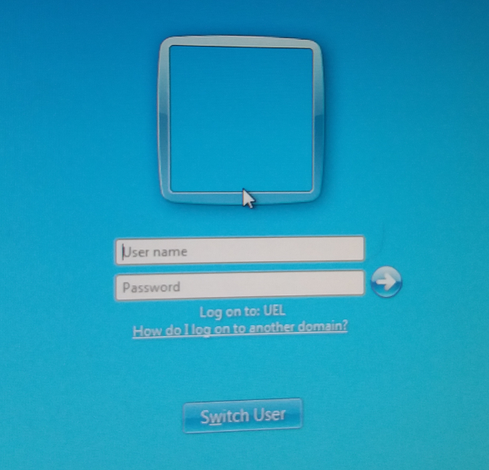
How to log into the computer system
Press CTRL+ALT+DELETE to log on
Log in using your UEL username and password
Example:
Username: u1234567
Password: 23-feb-97
University of East London - London's leading university for civic engagement

Slide 5
How to log into the Intranet?
Open a web browser and type intranet.uel.ac.uk to login to intranet (internal UEL website).
Login credentials e.g. u123456@uel.ac.uk and your password (example: 23-feb-95 or 23Feb95)
University of East London - London's leading university for civic engagement

Slide 6
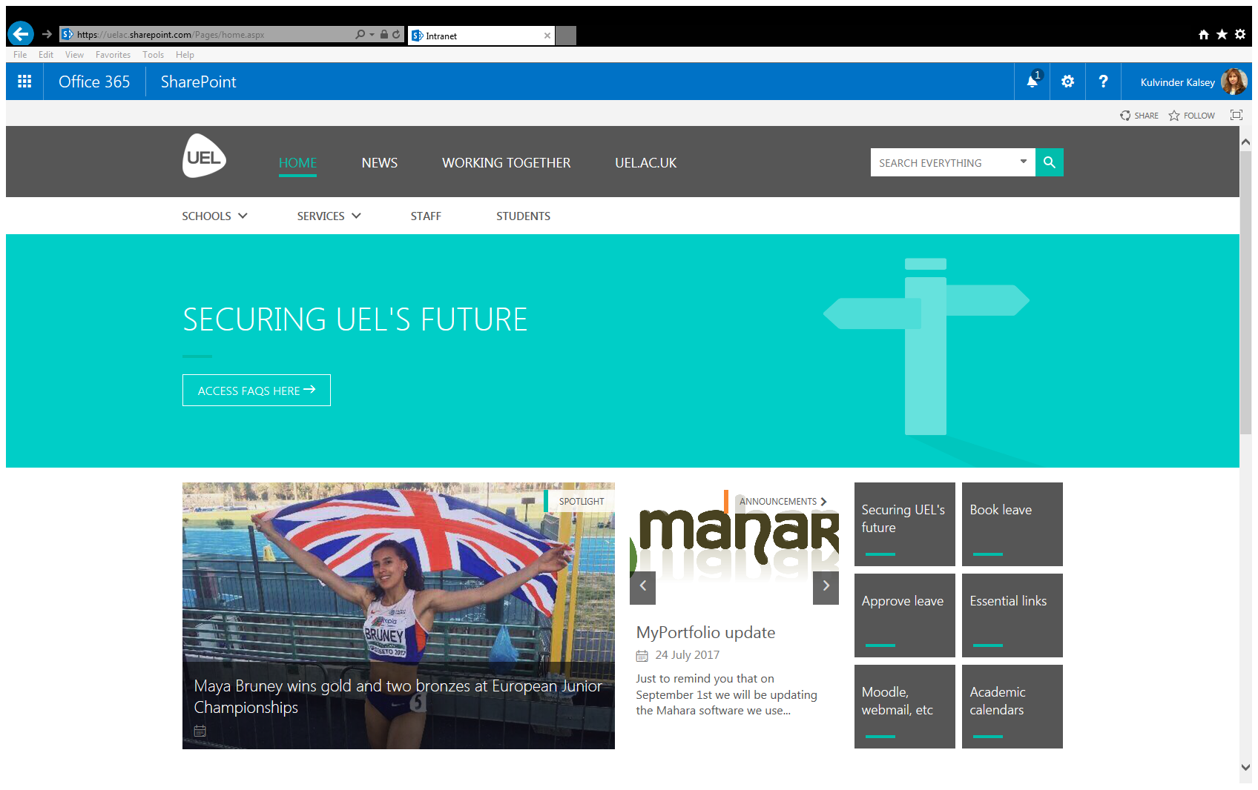

Slide 7
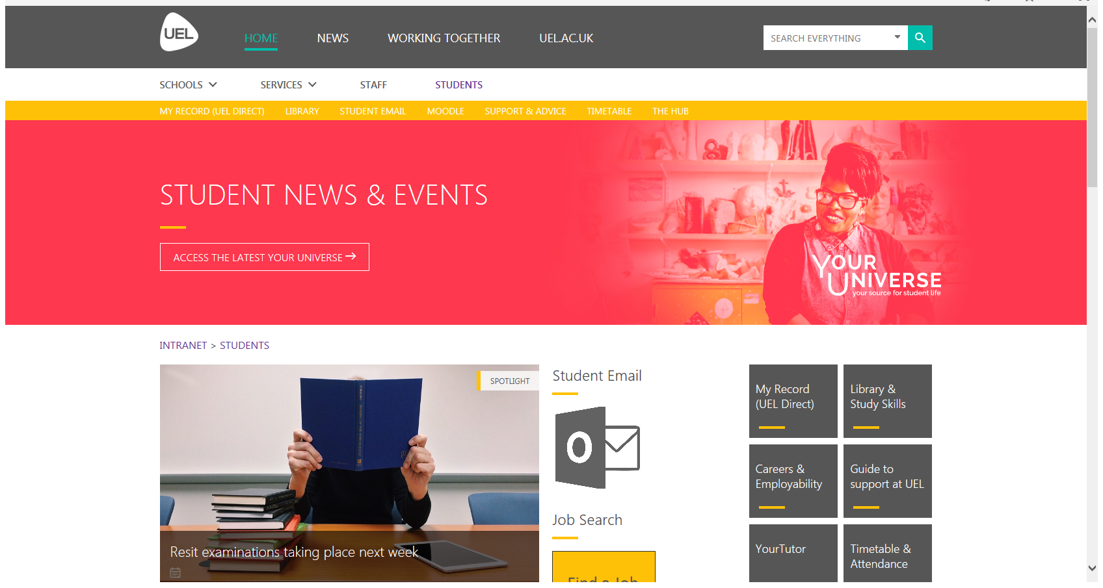
University of East London - London's leading university for civic engagement

Slide 8
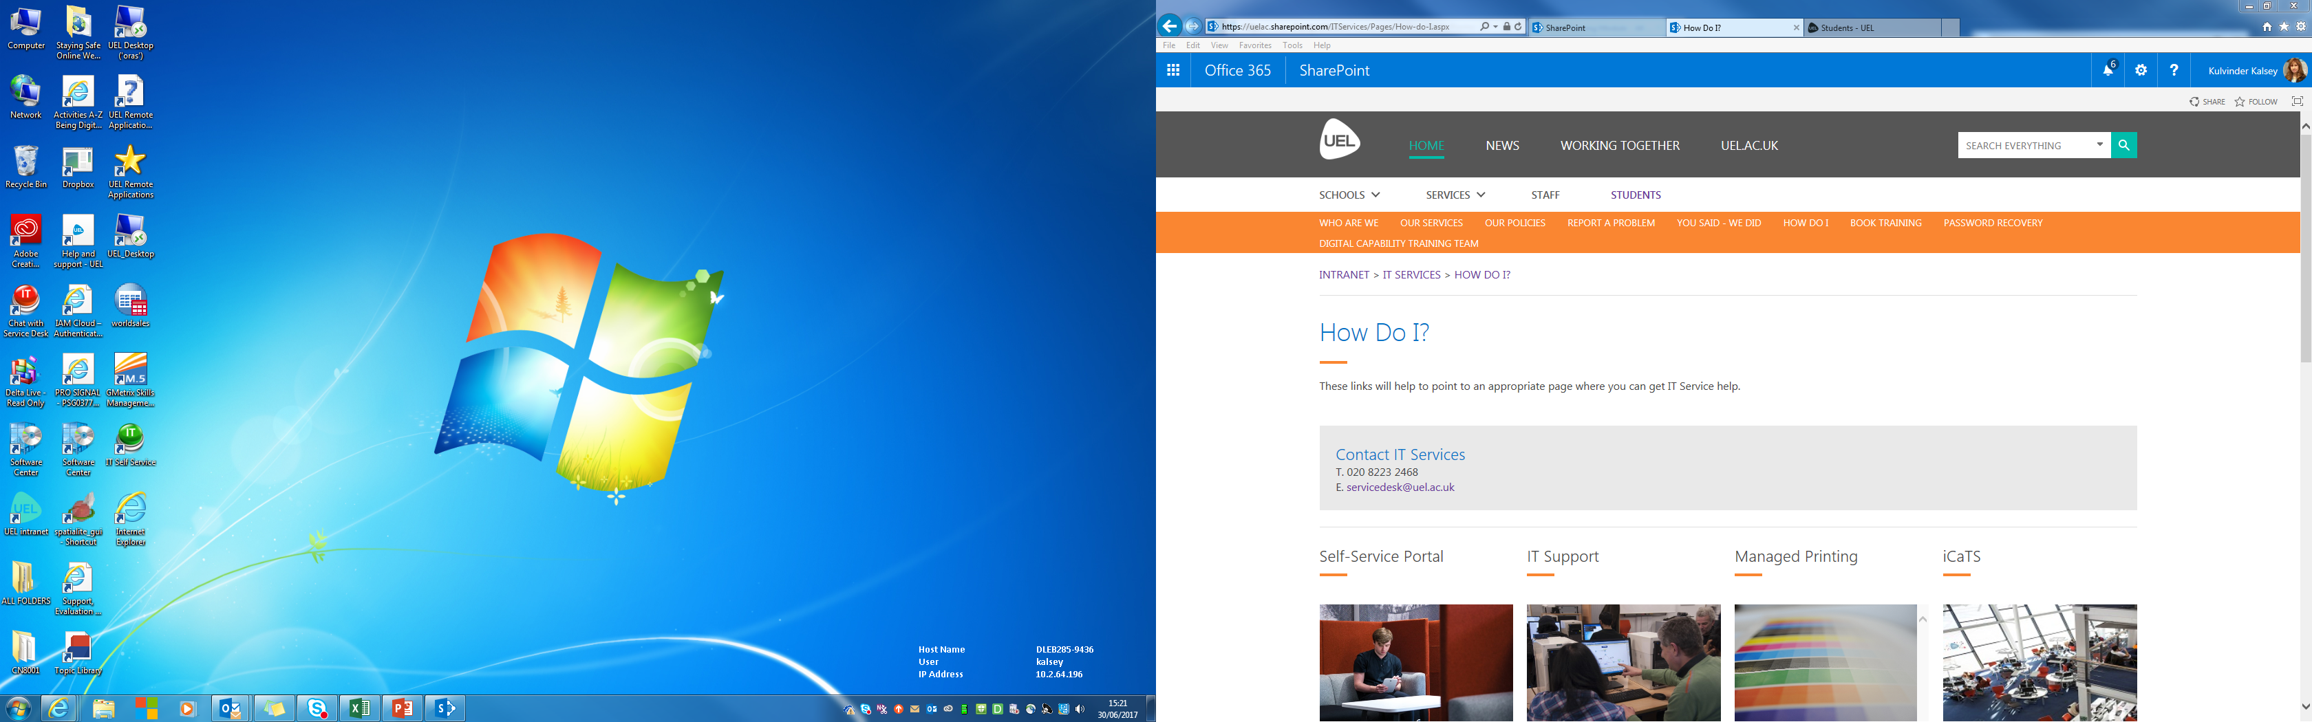
How to Contact IT Services?
OR:
Email: servicedesk@uel.ac.uk
Phone: 020 8223 2468
University of East London - London's leading university for civic engagement

Slide 9
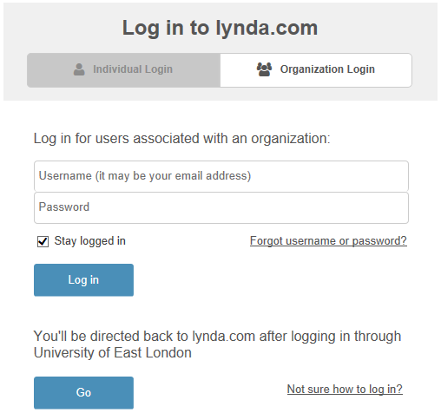
Go beyond the training
Head to Lynda.com
Click here
Then there!
University of East London - London's leading university for civic engagement

Slide 10
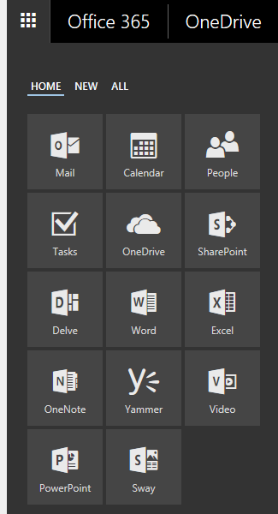
Office 365/OneDrive
All of Microsoft Office
Word
Excel
PowerPoint
Outlook
More…
Anywhere, on any device
1TB of storage (OneDrive)
OneNote
University of East London - London's leading university for civic engagement

Slide 11
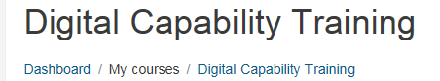


Slide 12
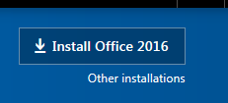
Freebees
Download Office 2013 on your tablet go to PLAY STORE and typing Office 365 in the search.
To download Office 2013 on Windows or Mac device, go to
https://login.microsoftonline.com/
log in then click on the settings button (next to the bell on the top toolbar) Office 365 settings install and manage software
University of East London - London's leading university for civic engagement

Slide 13
Points to remember…
To use strong password
To be aware of scam emails/SMS
To be aware of when clicking on the links in an email
Must not share your password with anyone
To log off the computer or other devices when leaving them unattended
To beware when sharing sensitive data on social media

Slide 14

Any Question?

