Slide 1



Email Migration for students
PM : Byron Bernard l BA : Fernando Guerrero l TA : Ghaffar Khan

Slide 2


Table of contents
1. Email and Calendar Migration Overview
Student perspective
Outlook clients
Outlook Web Access – OWA
Mobile devices configuration
O365 email policies
2. Possible Enquiries and Incidents
Enquiries for preparation
Enquiries for migration completed or post migration
Incidents during and post migration
3. Escalation procedures for pre-migration
4. Escalation procedure post-migration
5. Documents
6. Project Approach, Timescale, Comms…

Slide 3
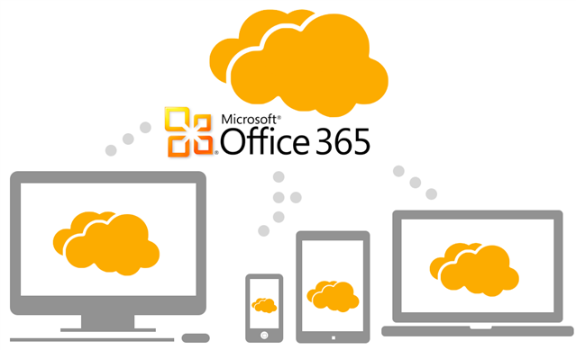
1. Email and Calendar Migration Overview
Student perspective
Automatic Notification & Confirmation email
Restart Outlook First time login to O365 / Sync items with 0365
Start preparation
Start Migration
Migration Completed
Email Service – On premise
Sync
Email service - O365
Migration window (Mailboxes, archive items, Calendar, People and Tasks)
Synchronisation period – A few mins
Post migration
Note: Lync, OneDrive and SharePoint data will remain unaffected
Outlook clients:
- Windows Outlook 2013
- MAC Microsoft Outlook for MAC 2011
Outlook Web Access – OWA:
Outlook Web Access is a web based app that allows you to access your email, contacts and calendar in Office 365. Users can get started with O365 outlook web app by going to the existing webmail.uel.ac.uk which will direct them to the new page http://outlook.com/owa/uel.ac.uk

Slide 4
1. Email and Calendar Migration Overview
Mobile devices configuration:
All mobile devices with Android, IOS, Windows and Blackberry can configure email settings to O365 :
- Server name: outlook.office365.com
- Your username: username@uel.ac.uk
- Password: your password
O365 email policies
Mailbox – Retention policy
Name | Retention Action | Retention Period
Default 2 years move to archive* | Archive | 730 days
Deleted items* | Delete | 30 Days
Junk email* | Delete | 30 Days
Deleted user mailboxes will be kept for 30 days. This setting cannot be changed.
Mobile Device Mailbox Policy
Name | Action | Comment
Allow mobile devices that don't fully support these policies to synchronize | Enable | Any mobile device can connect to O365 even if it doesn’t fully support the policies below.
Allow Simple Device Password | Enabled
Minimum password length: | Enable | 4 Characters
Require sign-in after the device has been inactive for 15 mins | Enable | After 15 Minutes

Slide 5
2. Possible Enquiries and Incidents
Enquiries for preparation
Migration schedule : http://www2.uel.ac.uk/it-services/o365
Empty the deleted items folder.
Info available – URL links and contacts(Libraries, Hub, Website, FAQs, Self-service and Service desk team).
General enquires about preparation for migration.
Enquiries for migration completed or post migration
Migration completed, confirmation email – User instructions restart Outlook, first login.
Outlook clients -Windows, MAC - first time login instructions.
O365 Outlook Web Access OWA - first time login instructions.
Connecting mobile devices (IOS, Android, Windows, other..).
FAQs.
Incidents during and post migration
Email accounts not migrated due to Incidents during the migration.
  Incident : Type of file not supported in O365.
  Incident : Corrupted items.
  Other Incidents to workaround.
Email account incidents after migration completed.
  Incident : Unable to Sync O365 – First login.
  Incident : Missing items (Mailboxes, Calendar, People, Tasks).
  Other Incidents to workaround.

Slide 6
3. Escalation procedures for pre-migration
Special requests
Infrastructure & Architecture Team
Comms for preparation
UEL O365 email website
www.uel.ac.uk/it-services
On site support
Technical Support Team
FAQs
www.uel.ac.uk/it-services/o365
General enquires.
Emptying deleted items folder.
Configuring mobile devices.
Service desk
Support contacts :
Self-service (Log ticket)
https://uel.topdesk.net
IT Service Desk servicedesk@uel.ac.uk
Hub Student Union
Library Contact Points

Slide 7
4. Escalation procedure post-migration
Review migration process, Batch migration incidents and remediation of email accounts cancelled
Infrastructure & Architecture Team
Confirmation email
UEL O365 email website
www.uel.ac.uk/it-services
Identify cause of fault / On site support …
Resolve any business as usual issues …
Technical Support Team
FAQs
www.uel.ac.uk/it-services/o365
Migration queries
Connect mobile devices to O365
Check if this is a unique incident or batch related or email service incident
Service desk
Support contacts :
Self-service (Log ticket)
https://uel.topdesk.net
IT Service Desk servicedesk@uel.ac.uk
Hub Student Union
Library Contact Points

Slide 8
5. Support documents
Support documents
Connecting mobile devices
  IOS document
  Android - Samsung Galaxy Tablet document
Preparing your email items
  Empty deleted items document
Migration completed
  Confirmation email
FAQs : http://www.uel.ac.uk/it-services/o365/

Slide 9
6. Project Approach, Timescale, Comms…
Project Approach
Project Timescale
Pre and Post Communications

Slide 10
Questions?

