Slide 1

Student IT Induction (UEL)

Slide 2

Who am I?
Kulvinder Kalsey
Digital Capability Trainer
Docklands Campus
Room EB.2.85
020 8223 2468
servicedesk@uel.ac.uk

Slide 3
Agenda - Introduction to:
IT Services
  Log into UEL computer
  Change password
  IT self service portal
  Software Centre
  Printing service
Student Intranet page
  UEL Direct
  Student UEL email
  Moodle
  Turnitin
  Support & Advice
  Student Timetable
  THE HUB
Office 365
  One Drive (1TB of storage)
  Office online – Word, PowerPoint, Excel, OneNote etc.
Freebees
    Lynda.com
    MS Office 2016 Software
    MOS 2016 course
    Install office 2016
    Digital Training Service – online platform
    Free WiFi
Apps Available to download on mobile devices
Security point to remember

Slide 4
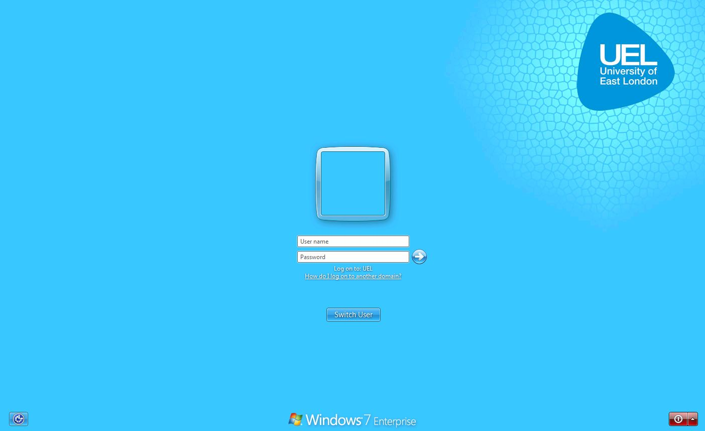

How to log into the computer system
Log in using your UEL username and password example:
Username: u1234567
Password: 23-feb-97

Slide 5
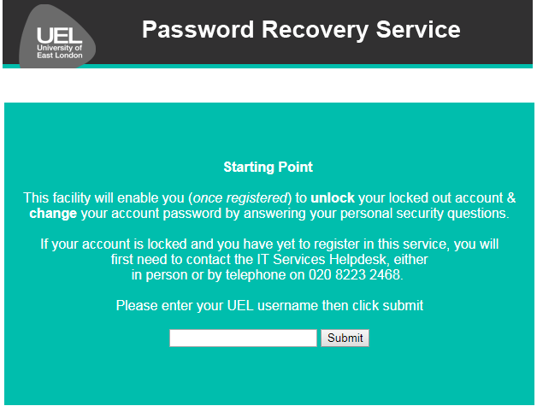
Go to: https://uel-prs.uel.ac.uk/

Slide 6
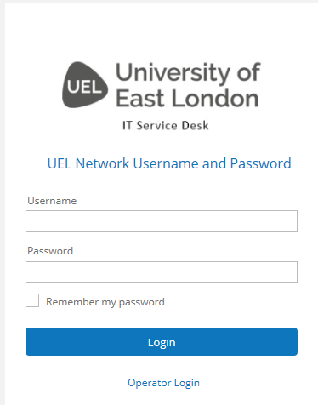
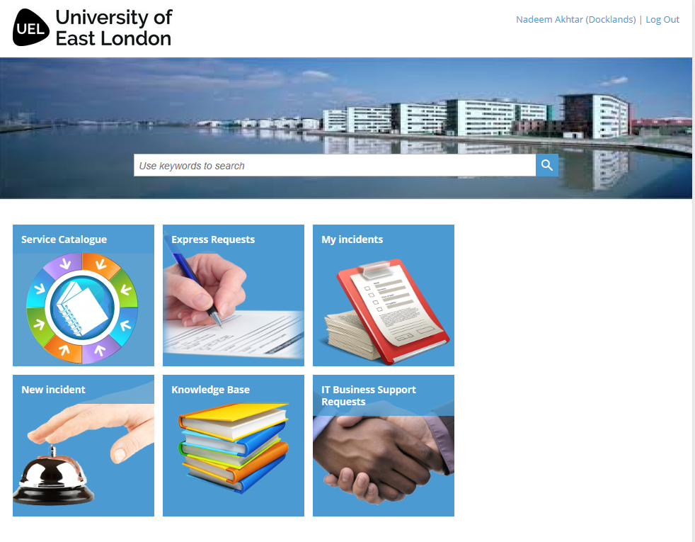

How to Contact IT Services?

Slide 7
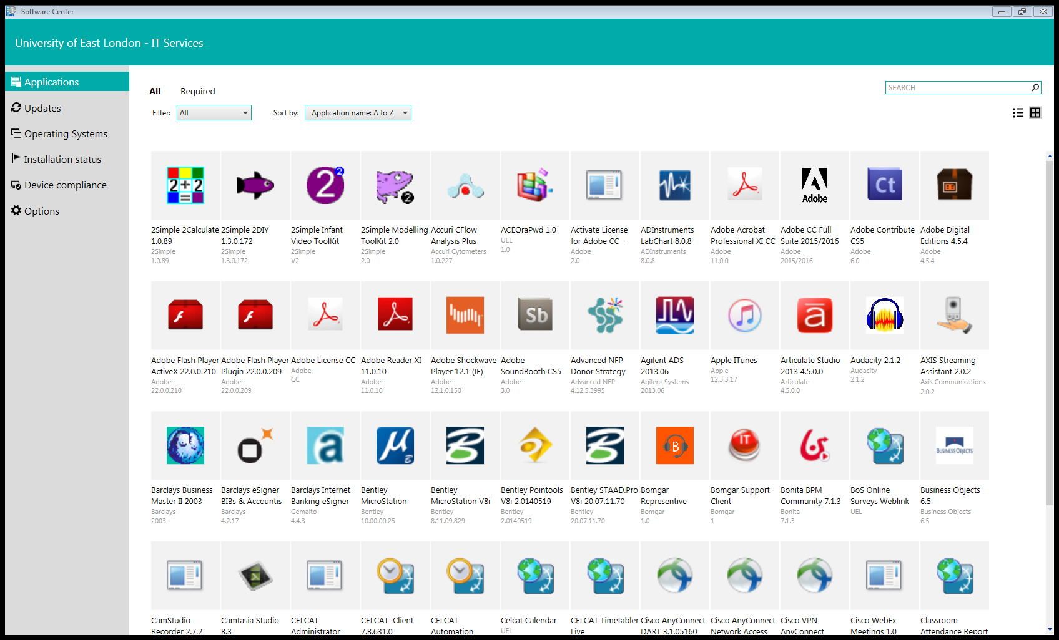

Software centre
Notes:
Software centre – download free software to use in UEL computers only

Slide 8

Student Printing
Black and white and colour printing facilities are operated by charged UEL ID cards.
Printing Cost:
Black and White per sheet:
A4 – 5p
A3 – 10p
Colour per sheet:
A4 – 25p
A3 – 50p

Slide 9

Connecting your personal device to Wi-Fi
Look for UEL Wi-Fi network ‘EDUROAM’
Enter your username (u000123@uel.ac.uk) and password

Slide 10
How to log into the Intranet?
Open a web browser and type https://intranet.uel.ac.uk to login to intranet (internal UEL website).
Login credentials e.g. u1234567@uel.ac.uk and your password (example: 23-feb-95)

Slide 11
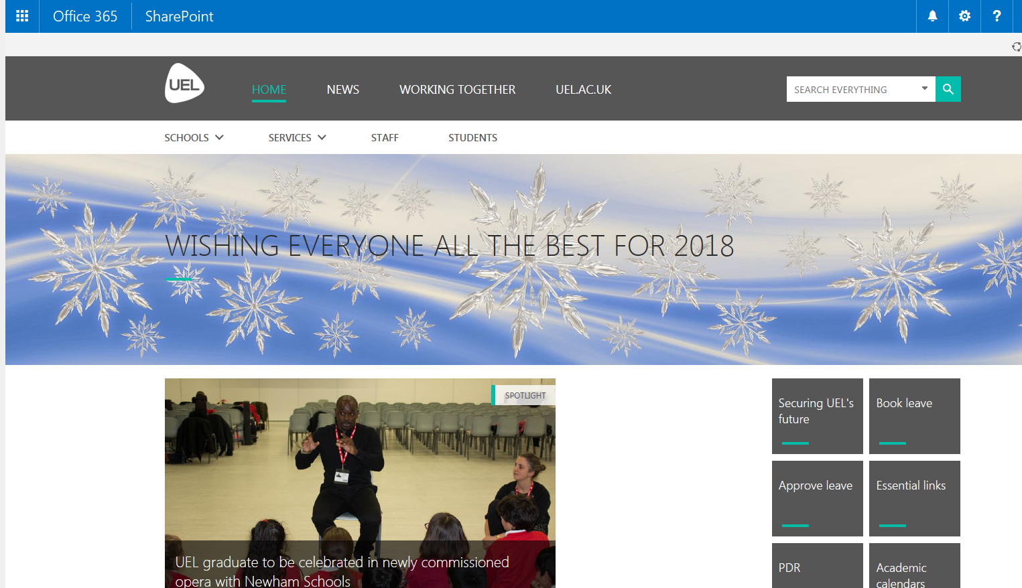

Slide 12
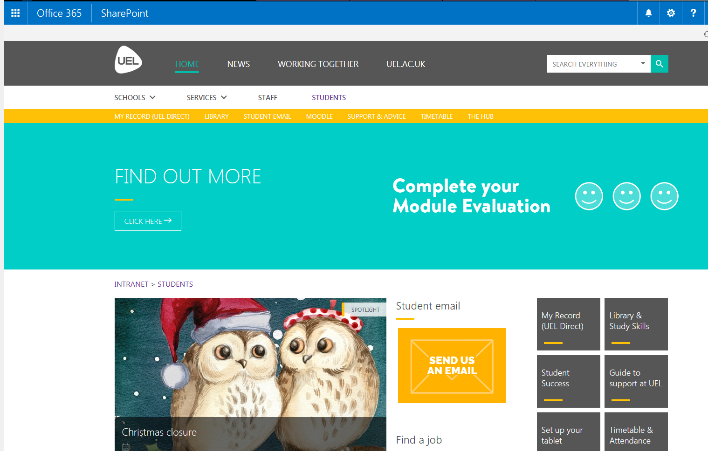

Slide 13

Office 365/OneDrive
All of Microsoft Office
  Word
  Excel
  Outlook
  OneNote
  More…
Anywhere, on any device
1TB of storage (OneDrive)

Slide 14
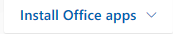
Microsoft Office 2016 Download
To download To Office 2016 products (e.g. Word, Excel, PowerPoint…) 2016 on your mobile device mobile device go to you phone’s application store or App Store
To download Office 2016 on Windows or Mac devices, go to https://intranet.uel.ac.uk → Office 365 → → Office 2016

Slide 15
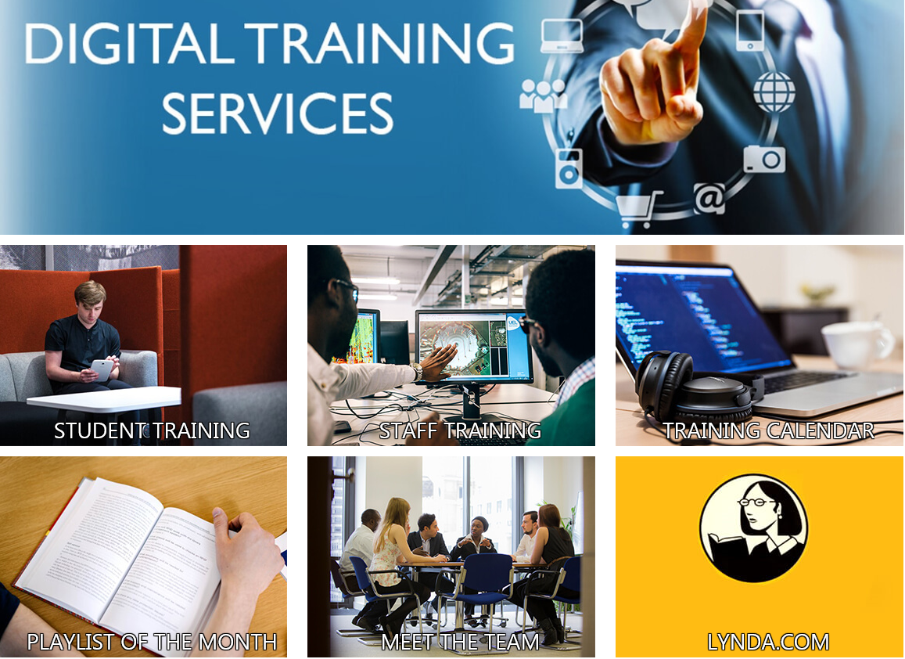
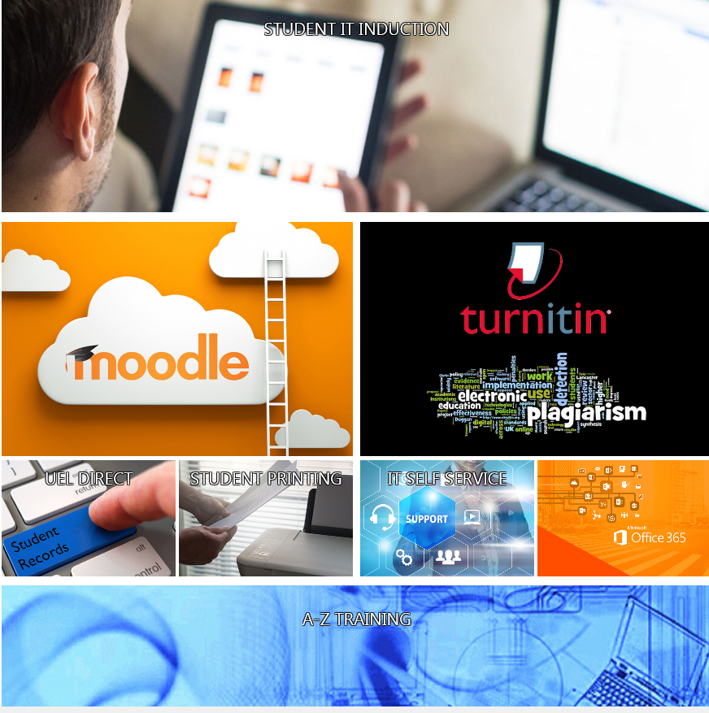
IT Support and Training

Slide 16






Access resources on your mobile devices
‘Get started’
Download Apps on your mobile devices

Slide 17
IT Facilities available to students
Self service
Printing service
Free Wi-Fi
Open access PCs/Mac
Collaboration space in the library
Software centre – free software download
Lynda.com
MOS
Office 365
Student Union Tech Team
UEL Intranet
OneDrive
Free – Microsoft Office 2016 download
1TB storage space
Notes:
IT Facilities available to students
Student Union Tech team provide support to students days (? Need to find out)

Slide 18
Security Points to Remember…
To use strong password
Must not share your password with anyone
To be aware of scam emails/SMS
To be aware of when clicking on the links in an email
Phishing emails; spotting a fake link, identifying phishing emails, how to deal with phishing emails
To log off the computer or other devices when leaving them unattended
To beware when sharing sensitive data on social media
Using the internet safely (https, log/locking machines, social media, Wi-Fi hotspots)

Slide 19
Useful links
Online IT Induction:
https://uelac.sharepoint.com/ITServices/Pages/DigitalTrainingServices/AllTrainingPages/IT-Introduction.aspx?csf=1&e=2SDMA1
UEL INTRANET PAGE: https://intranet.uel.ac.uk
IT INTRANET PAGE: https://intranet.uel.ac.uk/itservices
DIGITAL TRAINING SERVICE PAGE: https://uelac.sharepoint.com/ITServices/Pages/DigitalTrainingServices/LandingPages/dctt-home.aspx
THE HUB: https://uelac.sharepoint.com/StudentSupport/Pages/The-Hub.aspx
LIBRARY: https://uelac.sharepoint.com/LibraryandLearningServices/Pages/default.aspx
MOODLE: https://moodle.uel.ac.uk/
SUPPORT & ADVICE:
https://uelac.sharepoint.com/students/Pages/Support-and-advice.aspx
INFORMATION SECURITY: https://uelac.sharepoint.com/ITServices/Pages/Cyber-Awareness/Information-Security.aspx
LYNDA.COM: https://www.Lynda.com/

Slide 20

Thank you!
Contact US
020 8223 2468
servicedesk@uel.ac.uk

