Slide 1



UELSU Tech Team
September 2018

Slide 2


Tech Team Assistants
Alexandru
James
Jose
Kristiyan
Michael
Mohammad

Slide 3
Working pattern
Hubs at Stratford and Docklands
2 hr shifts (Tue and Thu)
Term time only
First point of contact

Slide 4




First few weeks of the semester A
High demand
Main enquiries
  General tablet set up
  Kortex
Seeing up 100 people per shift
at both campuses

Slide 5

Most popular topics
General Set up
Kortex
UEL account set up
MS Office applications
UEL Direct
Moodle
WIFI

Slide 6
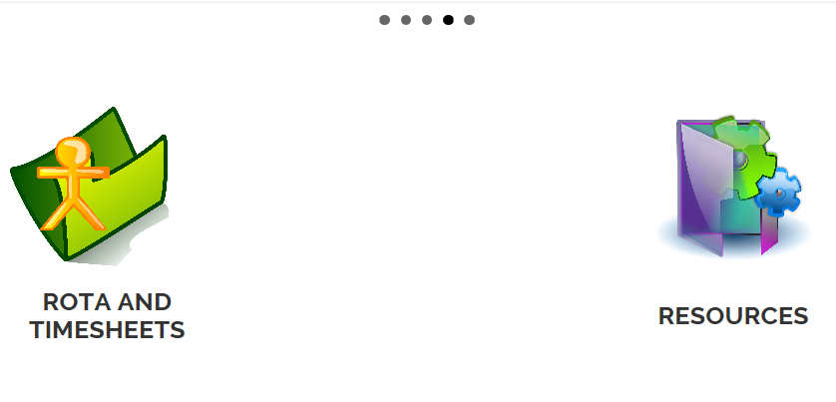
uelunion.org/tt
Main tech team webpage
Link to rota and resources
Make your suggestions how to improve it

Slide 7

findmyshift.co.uk
Individual login
Show your availability by Thursday
Submit timesheets
Rota is normally finalised on Friday
Wages paid once a month
Timesheets deadline - 10th of each month

Slide 8

Questions and suggestions

